Slide 1
Diversity, Equity, & Inclusion (DEI) in ASHRAE
Building a stronger culture of equity, diversity,
and inclusión in ASHRAE will help the Society to be
more creative, innovative, and resilient, drive Society
performance and improve member and staff retention.
The aim is to remove barriers experienced
by underrepresented groups to articulate the need
for their participation in ASHRAE
Inclusion is not a matter of political Correctness; It is a key to growth.
Jessie Jackson

Slide 2
ASHRAE
Core Values
ASHRAE´s Code of Ethics
In this and all other ASHRAE meetings, we will act with honesty, fairness, courtesy, competence, inclusiveness and respect for others, which exemplify our core values of excellence, commitment, integrity, collaboration, volunteerism and diversity, and we shall avoid all real or perceived conflicts of interests.
• Excellence
• Commitment
• Integrity
• Collaboration
• Volunteerism
• Diversity
Is equity still missing ??

Slide 3
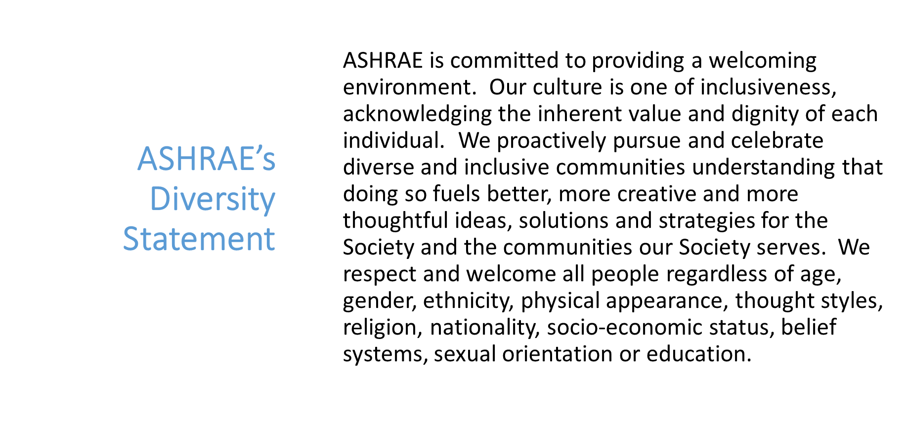
Diversity, Equity, & Inclusion (DEI) in ASHRAE

Slide 4
What is DEI
Diversity is the presence of differences that may include race, gender, religion, sexual orientation, ethnicity, nationality, socioeconomic status, language, (dis)ability, age, religious commitment, or political perspective. Populations that have been-and remain- underrepresented among practitioners in the field and marginalized in the broader society.
Equity is promoting justice, impartiality and fairness within the procedures, processes, and distribution of resources by institutions or systems. Tackling equity issues requires an understanding of the root causes of outcome disparities within our society.
Inclusion is an outcome to ensure those that are diverse actually feel and/or are welcomed. Inclusion outcomes are met when you, your institution, and your program are truly inviting to all. To the degree to which diverse individuals are able to participate fully in the decision-making processes and development opportunities within an organization or group.

Slide 5
“Diversity, Equity, Inclusion and ASHRAE: Does it Really Matter?”
What does our membership think?
Demographics fairly represent the industry | 56% agree
Women and people of color are underrepresented in the industry | 50% agree
Chapters and regions need to improve DEI efforts | 40-40 split | 20% not knowing one way or other
ASHRAE publically communicates its goals on diversity | 50% did not know | 50% communicates adequately
ASHRAE should do more to promote diversity? | 50% yes | 37% no | 12% did not know
Notes:
It is important to understand how the membership currently views DEI and how ASHRAE supports DEI.
• Fifty-six percent of respondents feels ASHRAE’s demographics fairly represent the industry, about half feel women and people of color are underrepresented in the industry.
• Respondents are split equally on whether Chapter and Regions need to improve DEI efforts with 20% not knowing one way or the other.
• Half of respondents did not know if ASHRAE publicly communicates its goals on diversity, and of those who did have an opinion, most felt that ASHRAE does communicate adequately.
• Half of the respondents felt ASHRAE should be doing more to promote diversity, equity and inclusion in the HVAC&R Industry, 37% indicated ASHRAE should not being doing more and 12% did not know.

Slide 6
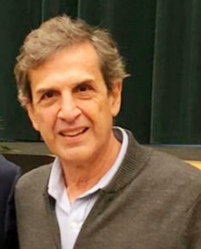
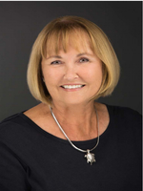
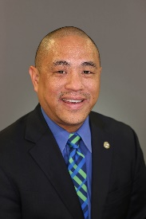
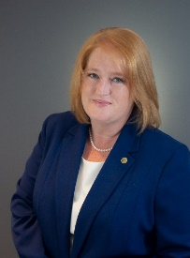
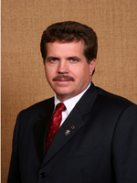
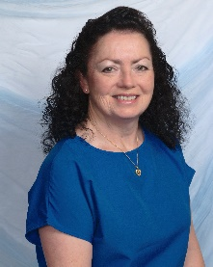
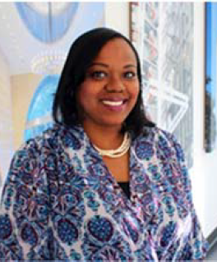
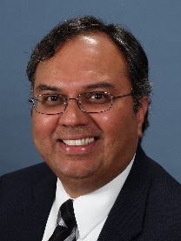
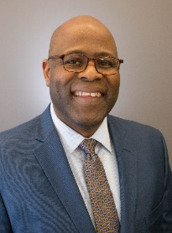
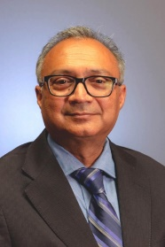
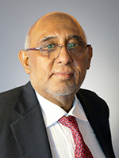
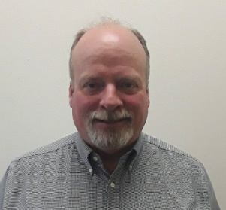
Diversity, Equity, & Inclusion (DEI) in ASHRAE BOD Subcommittee created by the Board January 2021
DEI BOD Sub-committee formed in 2021-2022
Purpose of the BOD DEI Subcommittee:
To advise and engage the Board of Directors on:
All matters relating to diversity, equity and inclusion - with a view to improving organizational awareness and performance in these areas amongst both staff and the Society membership
The establishment of annual budgets for DEI program and ongoing initiatives
The prioritization of inclusivity issues which have relevance to ASHRAE, together with plans for addressing these issues
Members of the BOD DEI Subcommittee
Andres Sepulveda (Chair); Adrienne Thomle (Vice Chair); Devin Abellon; Robin Bryant; Art Giesler; Eileen Jensen; Kishor Khankari; Tanisha Meyers-Lisle
Dunstan Macauley; Richie Mittal; Farooq Mehboob (Consultant); Steven Sill

Slide 7
Diversity, Equity, & Inclusion (DEI) in ASHRAE
Completed
Assigned 3 task groups
Procedures/Documents
Survey Development/Identifying Metrics
Program Development/ Education
Created a website and articles
Recommended ASHRAE sign CEO Action Pledge
Commit to building diverse leadership teams (staff & volunteer leadership)
Commit to share best practices
Promote this work with association membership
Sponsored DEI Forum in Las Vegas

Slide 8
Diversity, Equity, & Inclusion (DEI) in ASHRAE
Future Plans
DEI Consultant to survey and train BOD
Panel planned for Toronto
Create a video highlighting similarities and differences
Collaborate with industry partners (CIBSE,INWIC, NBI)

